Slide 1
Using PAS Services
MANAGED, USER-PROVIDED, SERVICE BROKERS, INSTANCE CREATION, APPLICATION BINDING, ENVIRONMENT VARIABLES, VCAP_APPLICATION
Platform Architecture Team

Slide 2








Pivotal Cloud Foundry (PCF) Architecture
Platform Runtime - Cloud Foundry
Services
HA Proxy LB
Service Broker
Dynamic Router
Service Nodes
App Manager UI
Cloud Controller
Blob Storage
Service
Application Manager
UAA
Login Server
Diego
Service Broker
Auctioneer
BBS
Service Nodes
Windows
Cell
Linux
Cell
CLI – Cmd Line Intf
Service
Rep
Rep
Terminal Window
Service Broker
+
=
Service Nodes
Messaging (NATS)
Service
Metrics Collection
App Log Aggregator

Slide 3
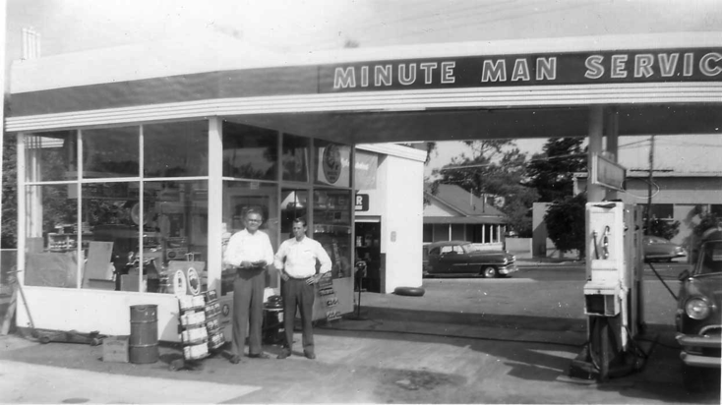
What is a Service?
Allows resources to be easily provisioned on-demand
Typically an external “component” necessary for applications
Database, cache, message queue, microservice, etc.
Can be a persistent, stateful layer

Slide 4

Types of Services
Managed - Fully integrated, with fully lifecycle management
Part of the market place of services
User-Provided – Created and managed external to the platform

Slide 5
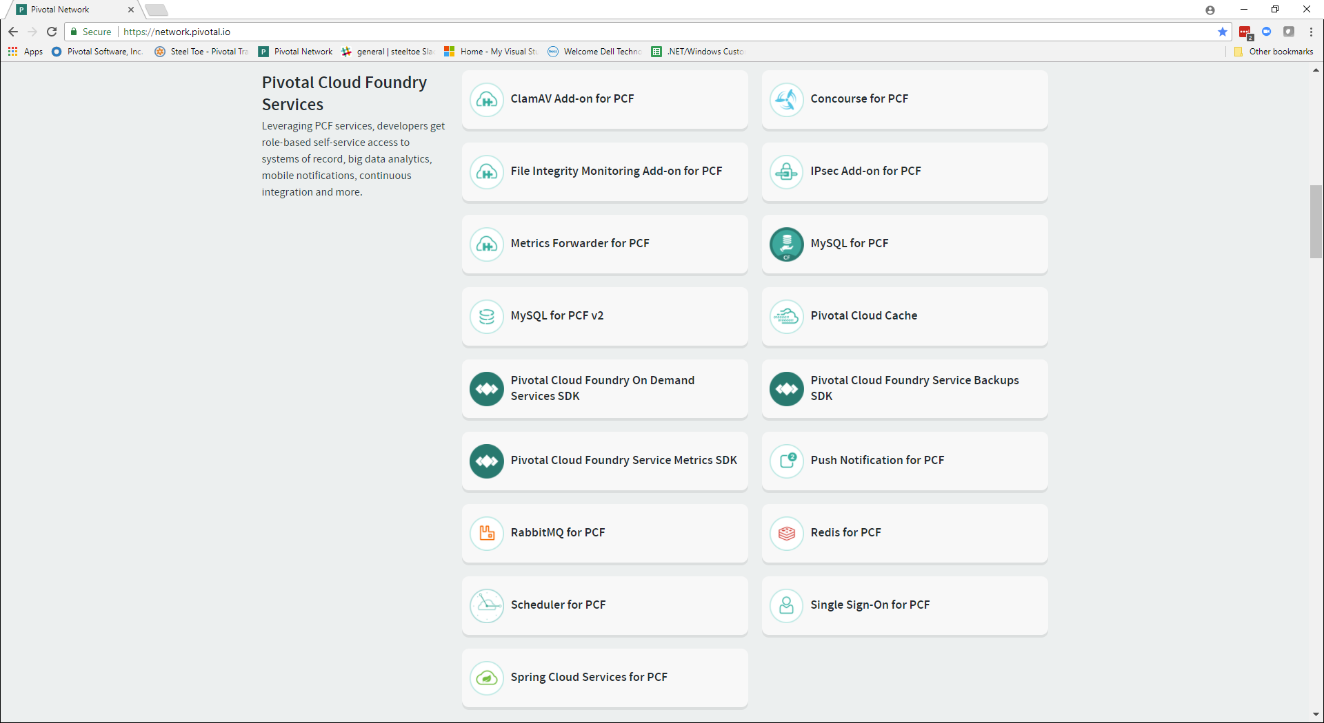

Pivotal Managed Services
https://network.pivotal.io/

Slide 6
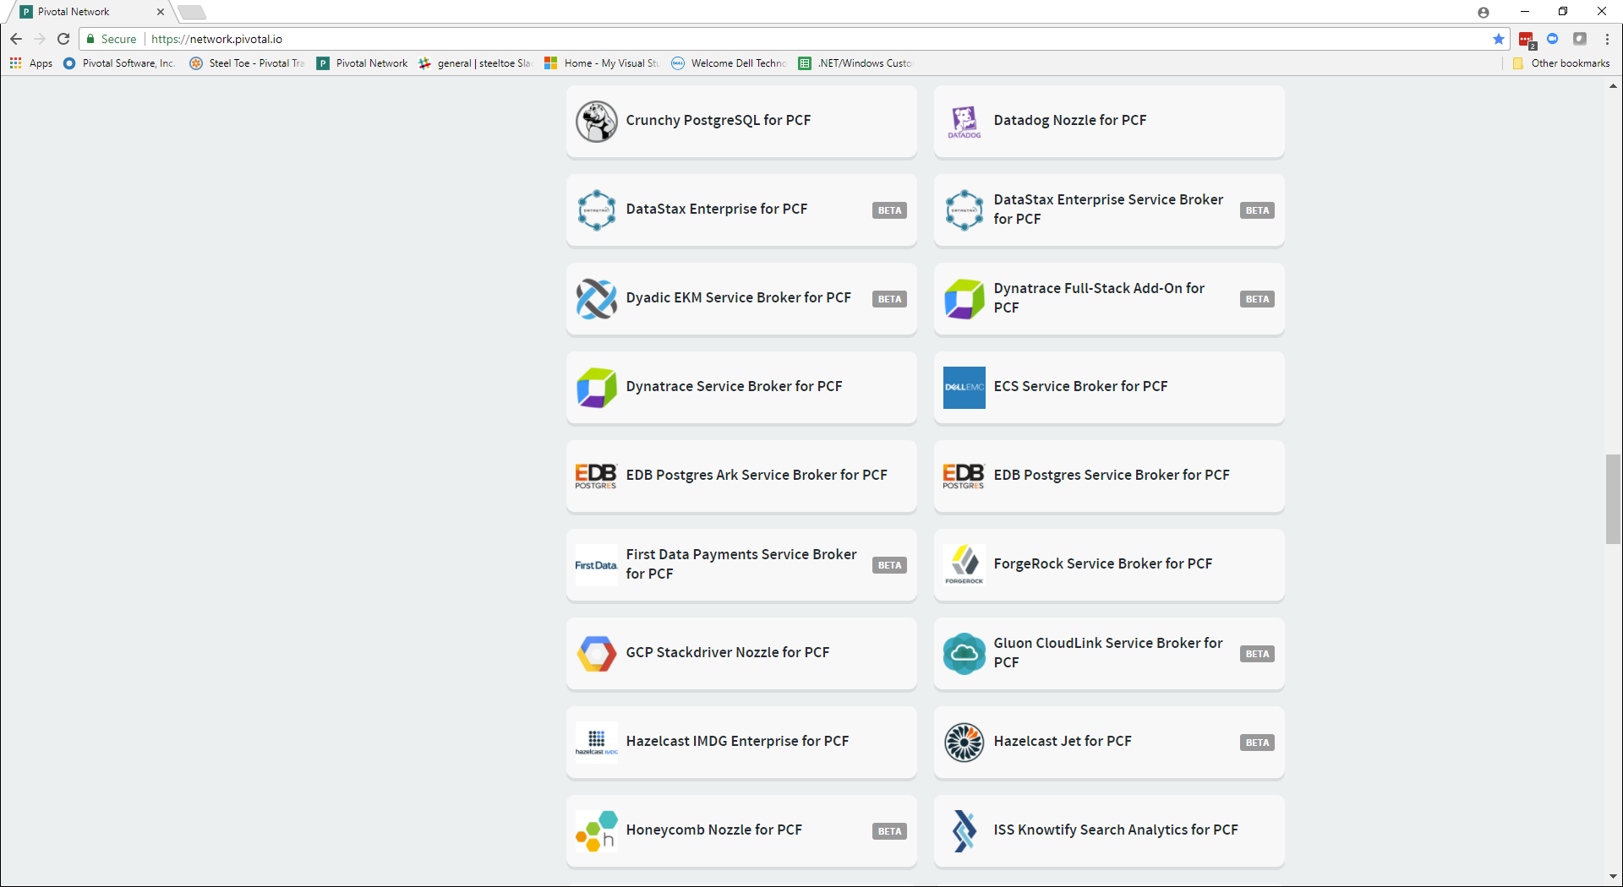
Third Party Managed Services
https://network.pivotal.io/

Slide 7
Managed Services
Integrated with Cloud Foundry
Services integrated with Cloud Foundry must implement the Service Broker API
Cloud Controller (CC) manages services using the API
Service Brokers implement the API
Advertise a catalog of service offerings and service plans
Create service instances
Bind applications to service instances
Unbind applications from service instances
Delete service instances

Slide 8
Creating and Binding a Service
Service
credentials
DB
CLI
create service (HTTP)
Cloud Controller
create service (HTTP)
Service
Broker
reserve resources
Data
Service
Router
bind service (HTTP)
bind service (HTTP)
obtain connection data
Cloud Foundry
Runtime (PCF)

Slide 9
User Provided Services
Service instances managed outside of Cloud Foundry
Behave like other service instances once created
Familiar CLI commands provide service instance configuration
cf create-user-provided-service ….
Example: An Oracle database managed outside of Cloud Foundry

Slide 10
Cloud Foundry Container Environment Variables
Used to communicate application environment & configuration to deployed containers
VCAP_APPLICATION
Application attributes – version, instance index, limits, URLs, etc.
VCAP_SERVICES
Bound services – name, label, credentials, etc.
CF_INSTANCE_*
CF_INSTANCE_ADDR, CF_INSTANCE_INDEX, etc.

Slide 11
VCAP_SERVICES Example
"VCAP_SERVICES": {
"p-config-server": [
{
"credentials": {
"uri": "https://config-bd112dd4-9870-4819-b9a6-62eb3311e27b.apps.testcloud.com",
"client_secret": "X3e2gKs5Oqhp",
"client_id": "p-config-server-5f0d1211-75f1-4105-9f94-7ec010de2d3a",
"access_token_uri": "https://p-spring-cloud-services.uaa.system.testcloud.com/oauth/token"
},
"syslog_drain_url": null,
"volume_mounts": [],
"label": "p-config-server",
"provider": null,
"plan": "standard",
"name": "myConfigServer",
"tags": [
"configuration",
"spring-cloud"
]
}
],
"p-service-registry": [
………..

Slide 12

Transforming How The World Builds Software
© Copyright 2017 Pivotal Software, Inc. All rights Reserved.

